Slide 1
CS4042 – Information Processing Techniques(IPT)
Week – 05
Oct 4-8, 2021
Instructor: Syed Zain Ul Hassan

Slide 2
Windows Services
A Windows service is a long-running program
It is designed to run as a background task with no interaction with the screen
UNIX calls these processes daemons
They often implement key system tasks such as
Anti Virus
Indexing
DNS
time synchronization
SSH
HTTP
IIS, etc.

Slide 3
View Windows Services
Command Prompt
Task Manager
Services Manager
Computer Manager

Slide 4
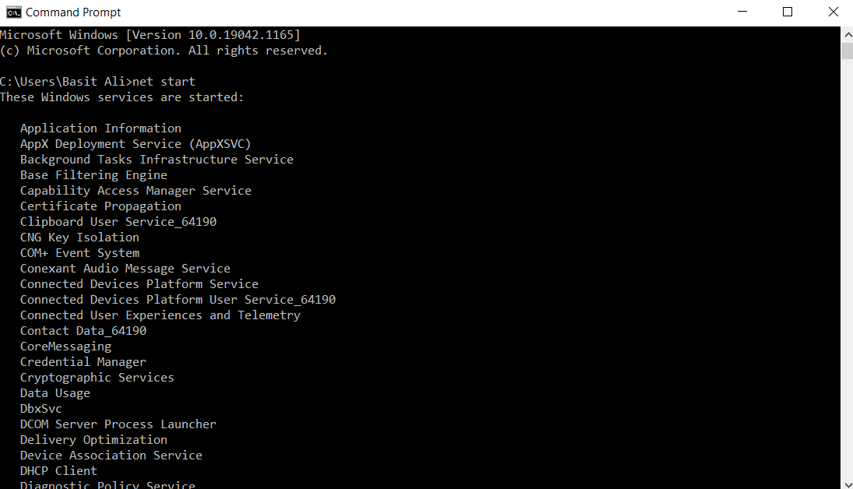
View Windows Services – Command Prompt

Slide 5
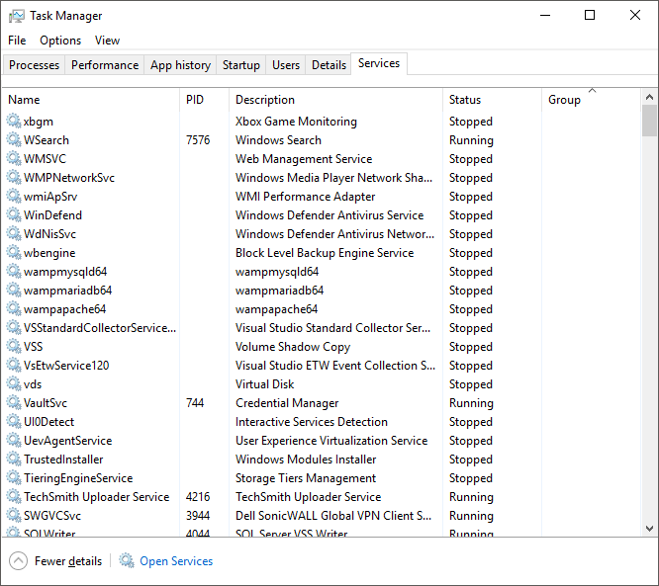
View Windows Services – Task Manager

Slide 6
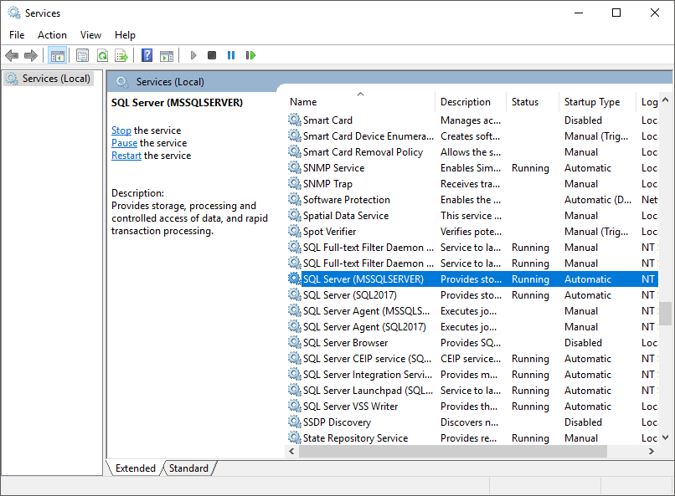
View Windows Services – Services Manager

Slide 7
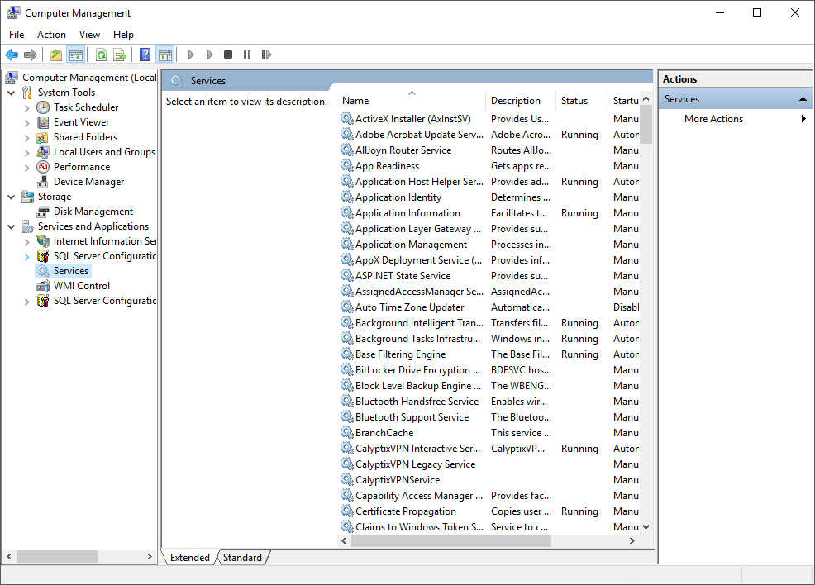
View Windows Services – Computer Manager

Slide 8
ServiceBase Class
The ServiceBase class is in the System.ServiceProcess namespace
All services are derived from this class
It provides several methods which should be overloaded to define the actions of the service

Slide 9
ServiceBase Methods
void OnStart(string[] args)
This is sent by the system when the service is started
Normally, the work performed by the service will be done by this method
void OnPause()
Called when the service is paused
A service is usually resumed after a pause and it is not necessary to release all resources held by the service

Slide 10
ServiceBase Methods
void OnContinue()
This resumes normal processing after the service has been paused
void OnStop()
This attempts to stop the service
The service might be started again at a later time

Slide 11
ServiceBase Properties
ServiceName
Allows the name of the service to be set or retrieved
CanStop
Boolean indicating whether the service can be stopped

Slide 12
Sample Service
We will now write a sample service
We must provide
A service
A main program for the service
A service installer
Our sample service will periodically write the time to a file

Slide 13
Installing the Service
Before you can install the service, you must write an installer
This extends System.Configuration.Install.Installer
It is included in the same assembly as the service it should install
It installs the service by using the service name, which must be set in the service

Slide 14
Installing / Uninstall the Service
To install the service use installutil which is located in
C:\WINDOWS\Microsoft.NET\Framework\<version>
To uninstall the service, use installutil /u <service.exe>

Slide 15
Installing the Service
To install the service
Start a command prompt and go to the directory containing the service assembly
installutil WindowsService1.exe
To start the service
Start the services control panel and click start
To uninstall the service
installutil /u WindowsService1.exe

Slide 16
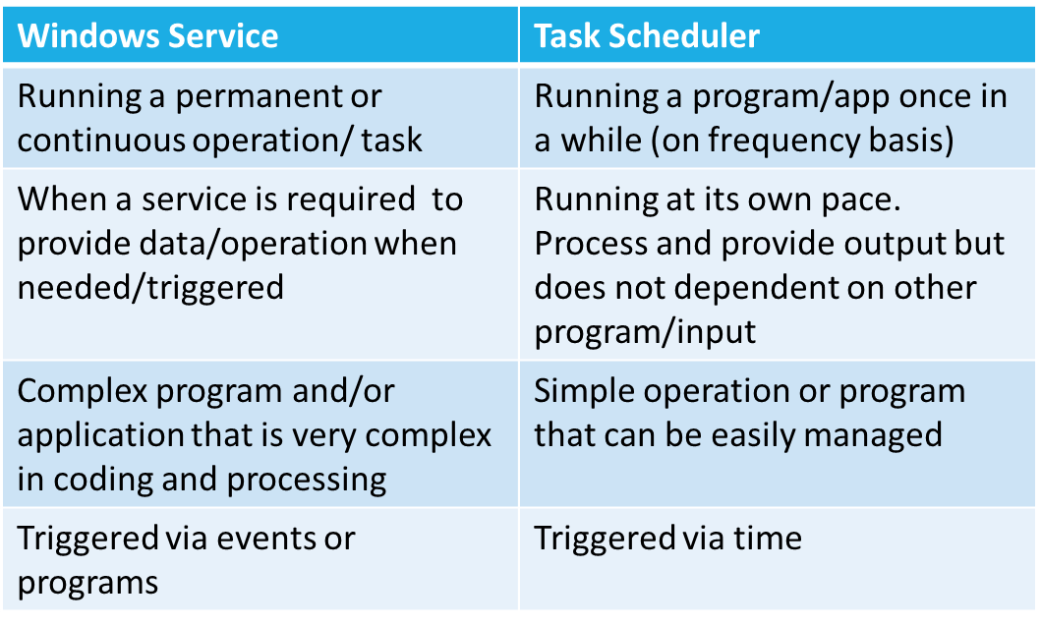
Windows Service v/s Task Scheduler

